Slide 1
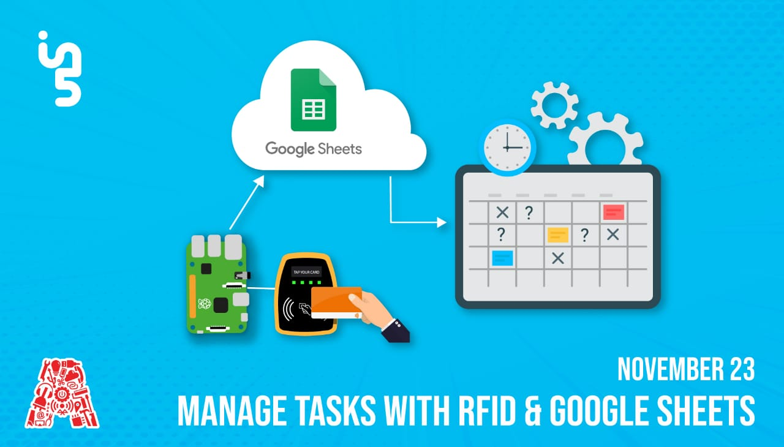

Slide 2
About the Assembly
A smart lab based out of In5 since Dec 2014
Over 250 free workshops done
ASSEMBLY: HACK - Embedded systems, iOT and hardware
ASSEMBLY: CODE - Software projects - APIs, frameworks, apps
Age range: 16-60 - students, professionals, entrepreneurs
Focus on smart technology and practical applications
Forum: members.theassembly.ae

Slide 3


Slide 4


Slide 5
TAG US ON OUR SOCIAL MEDIA
FACEBOOK
TWITTER
INSTAGRAM
YOUTUBE
The Assembly (@MakeSmartThings)
@MakeSmartThings
@MakeSmartThings
The Assembly

Slide 6

Overview
TOPICS:
Background of RFID
Real-Life Implementations
Components
Introduction to Raspberry Pi
Circuit Breakdown
Code Explanation

Slide 7

Introduction to RFID
Radio-Frequency Identification
Radio-frequency identification (RFID) uses electromagnetic fields to automatically identify and track tags attached to objects.
The tags contain electronically stored information. Passive tags collect energy from a nearby RFID reader's interrogating radio waves.
Mac OS 10.14

Slide 8
Advantages and Disadvantages of RFID
Advantages | Disadvantages
High Speed | Interferance
Multipurpose and many format | High Cost
High Accuracy | Overhead reading (fail to read)
Mac OS 10.14

Slide 9
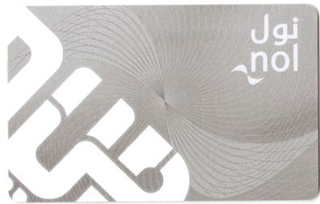
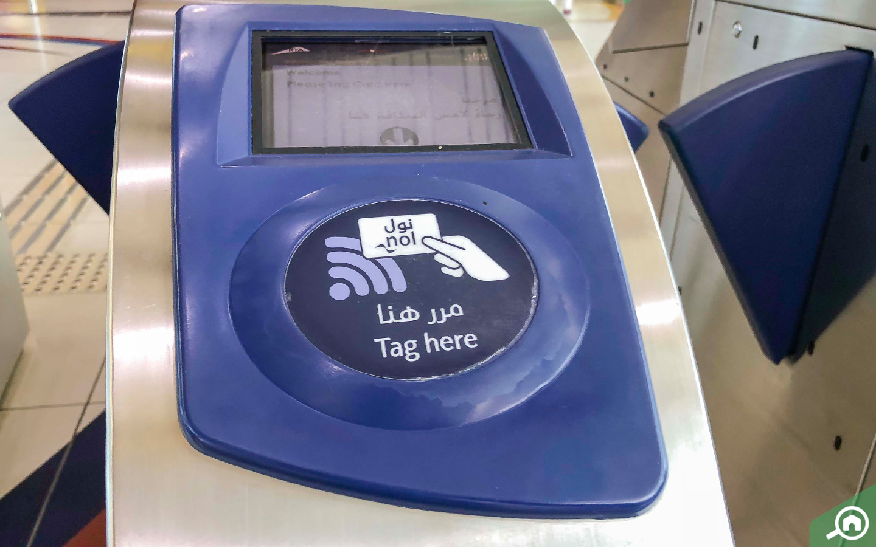
Real-Life Implementation of RFID
Mac OS 10.14

Slide 10


Dependencies
Download the files from GitHub
https://github.com/The-Assembly/Manage_Tasks_RFID
Download VNC Viewer to access the Raspberry Pi
https://www.realvnc.com/en/connect/download/viewer/

Slide 11
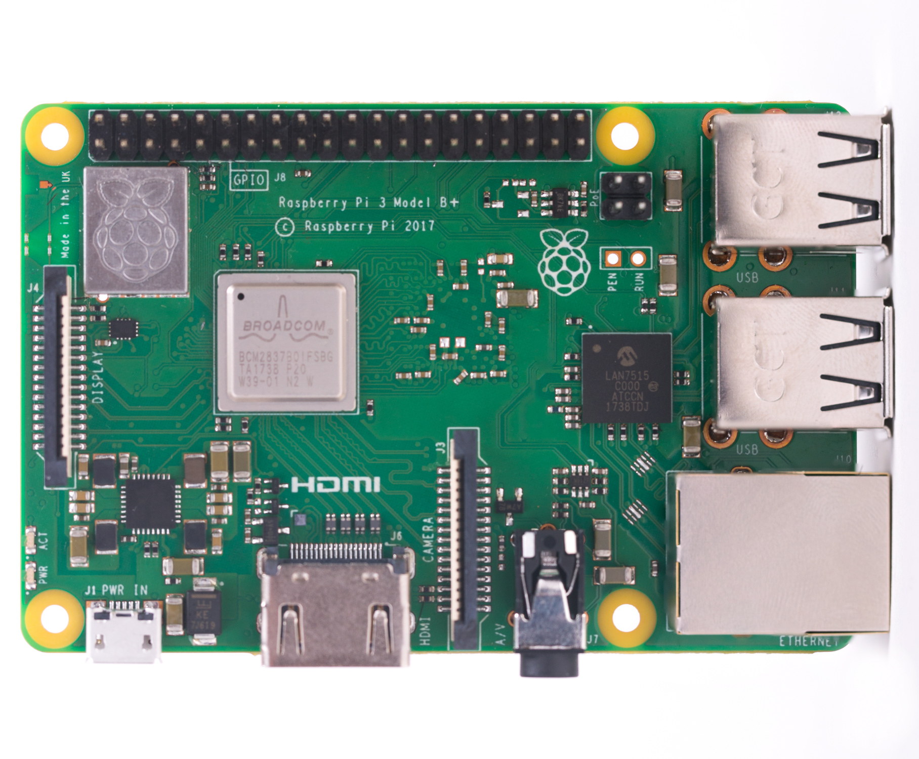
Components
Raspberry Pi
SoC: Broadcom BCM2837B0 quad-core A53 (ARMv8) 64-bit @ 1.4GHz
GPU: Broadcom VideoCore-IV
RAM: 1GB LPDDR2 SDRAM
Networking: Gigabit Ethernet (via USB channel), 2.4GHz and 5GHz 802.11b/g/n/ac Wi-Fi
Bluetooth: Bluetooth 4.2, Bluetooth Low Energy (BLE)
Storage: Micro-SD
GPIO: 40-pin GPIO header, populated
Ports: HDMI, 3.5mm analogue audio-video jack, 4x USB 2.0, Ethernet, Camera Serial Interface (CSI), Display Serial Interface (DSI)
Dimensions: 82mm x 56mm x 19.5mm, 50g
Mac OS 10.14

Slide 12
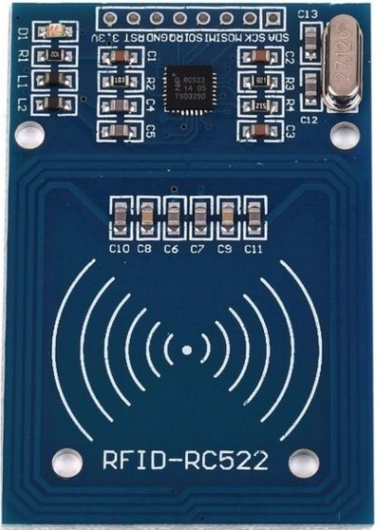
Components
RC522 – RFID Reader/Writer
Operating Current :13-26mA / DC 3.3V
Idle Current :10-13mA / DC 3.3V
Sleep Current: < 80uA
Peak Current: < 30mA
Operating Frequency: 13.56MHz

Slide 13
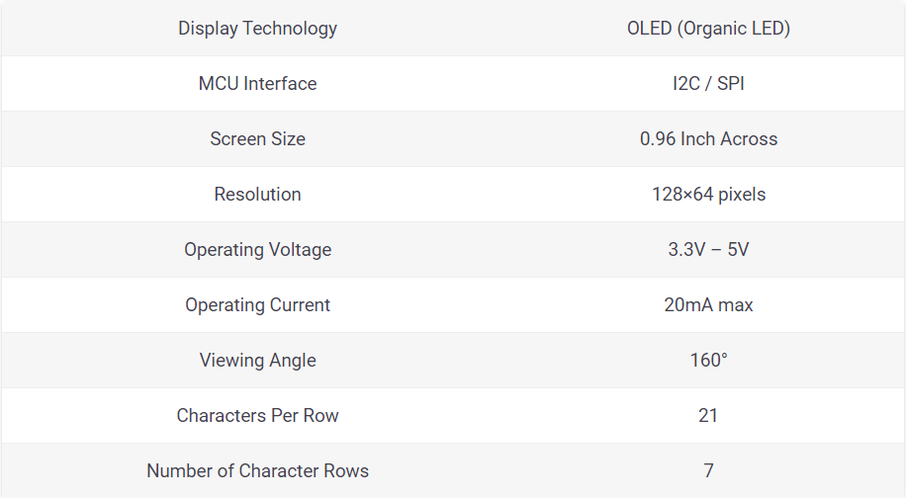
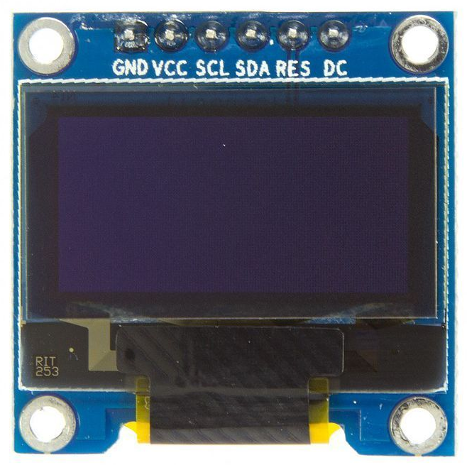
Components
OLED Screen
Mac OS 10.14

Slide 14
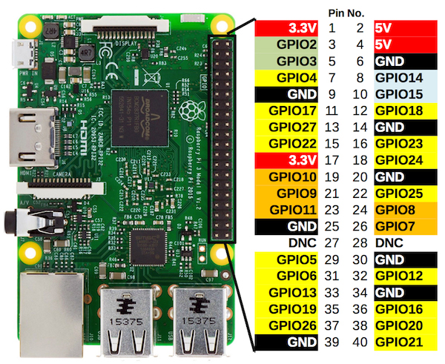
Introduction to Raspberry Pi
26 GPIOs @ 3.3V Output
2 5V Pins
2 3.3V Pins
8 GND Pins

Slide 15
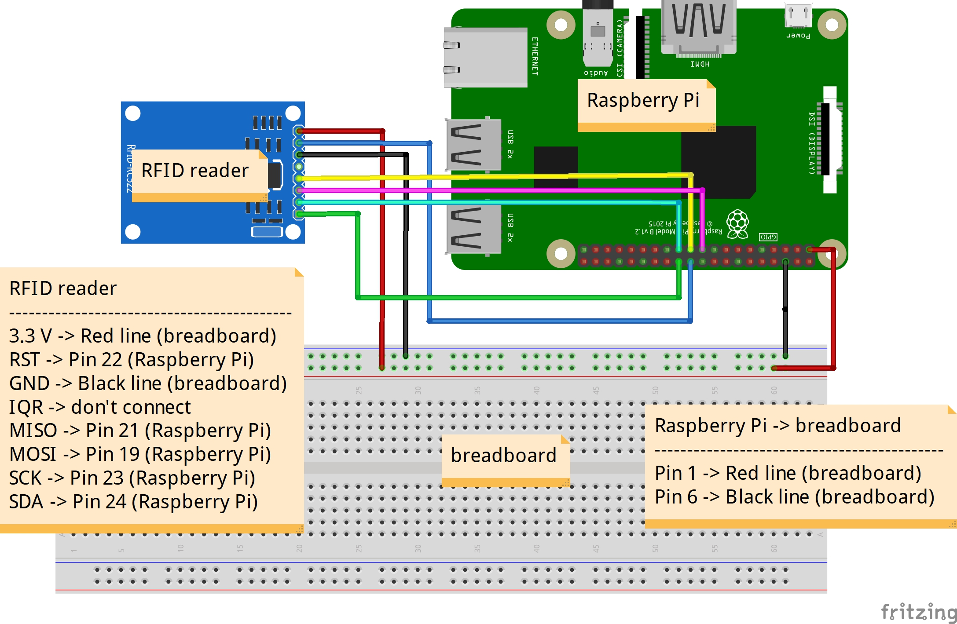
RFID - Circuit
Mac OS 10.14

Slide 16
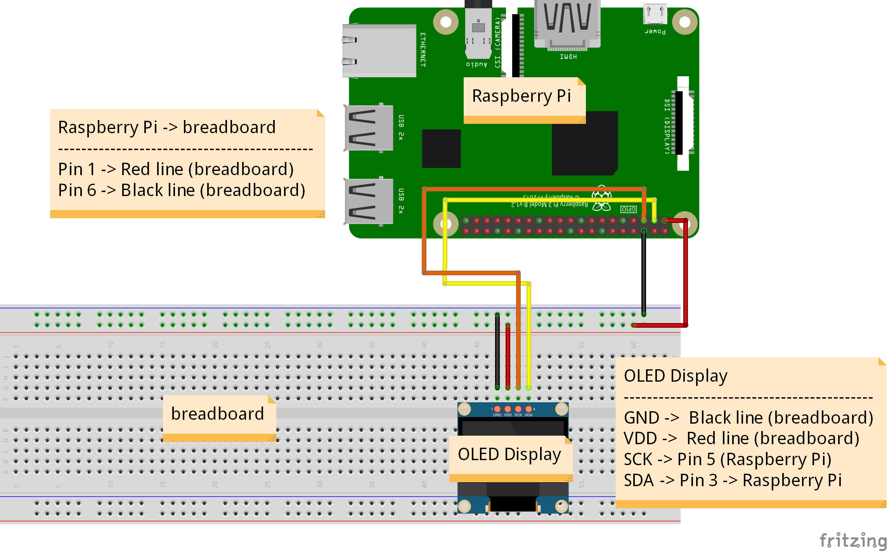
OLED- Circuit
Mac OS 10.14

Slide 17
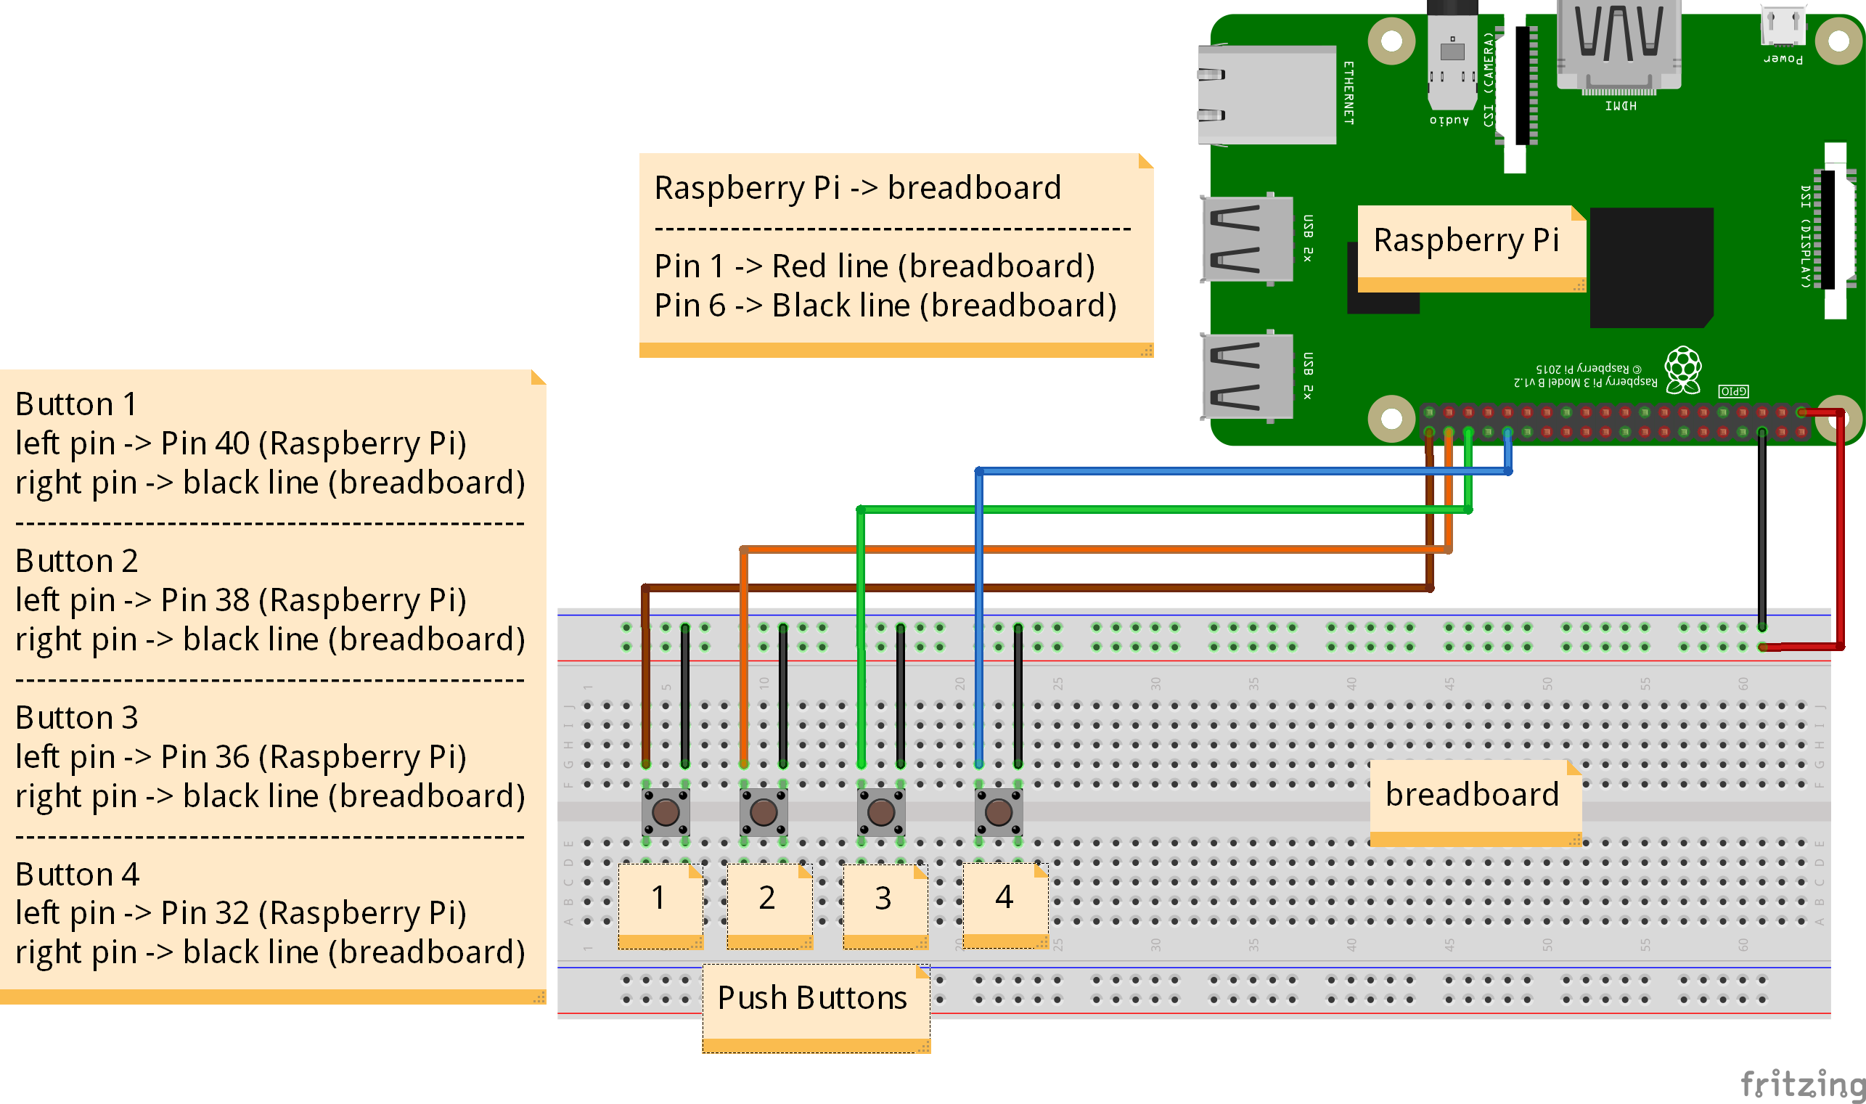
Buttons- Circuit
Mac OS 10.14

Slide 18
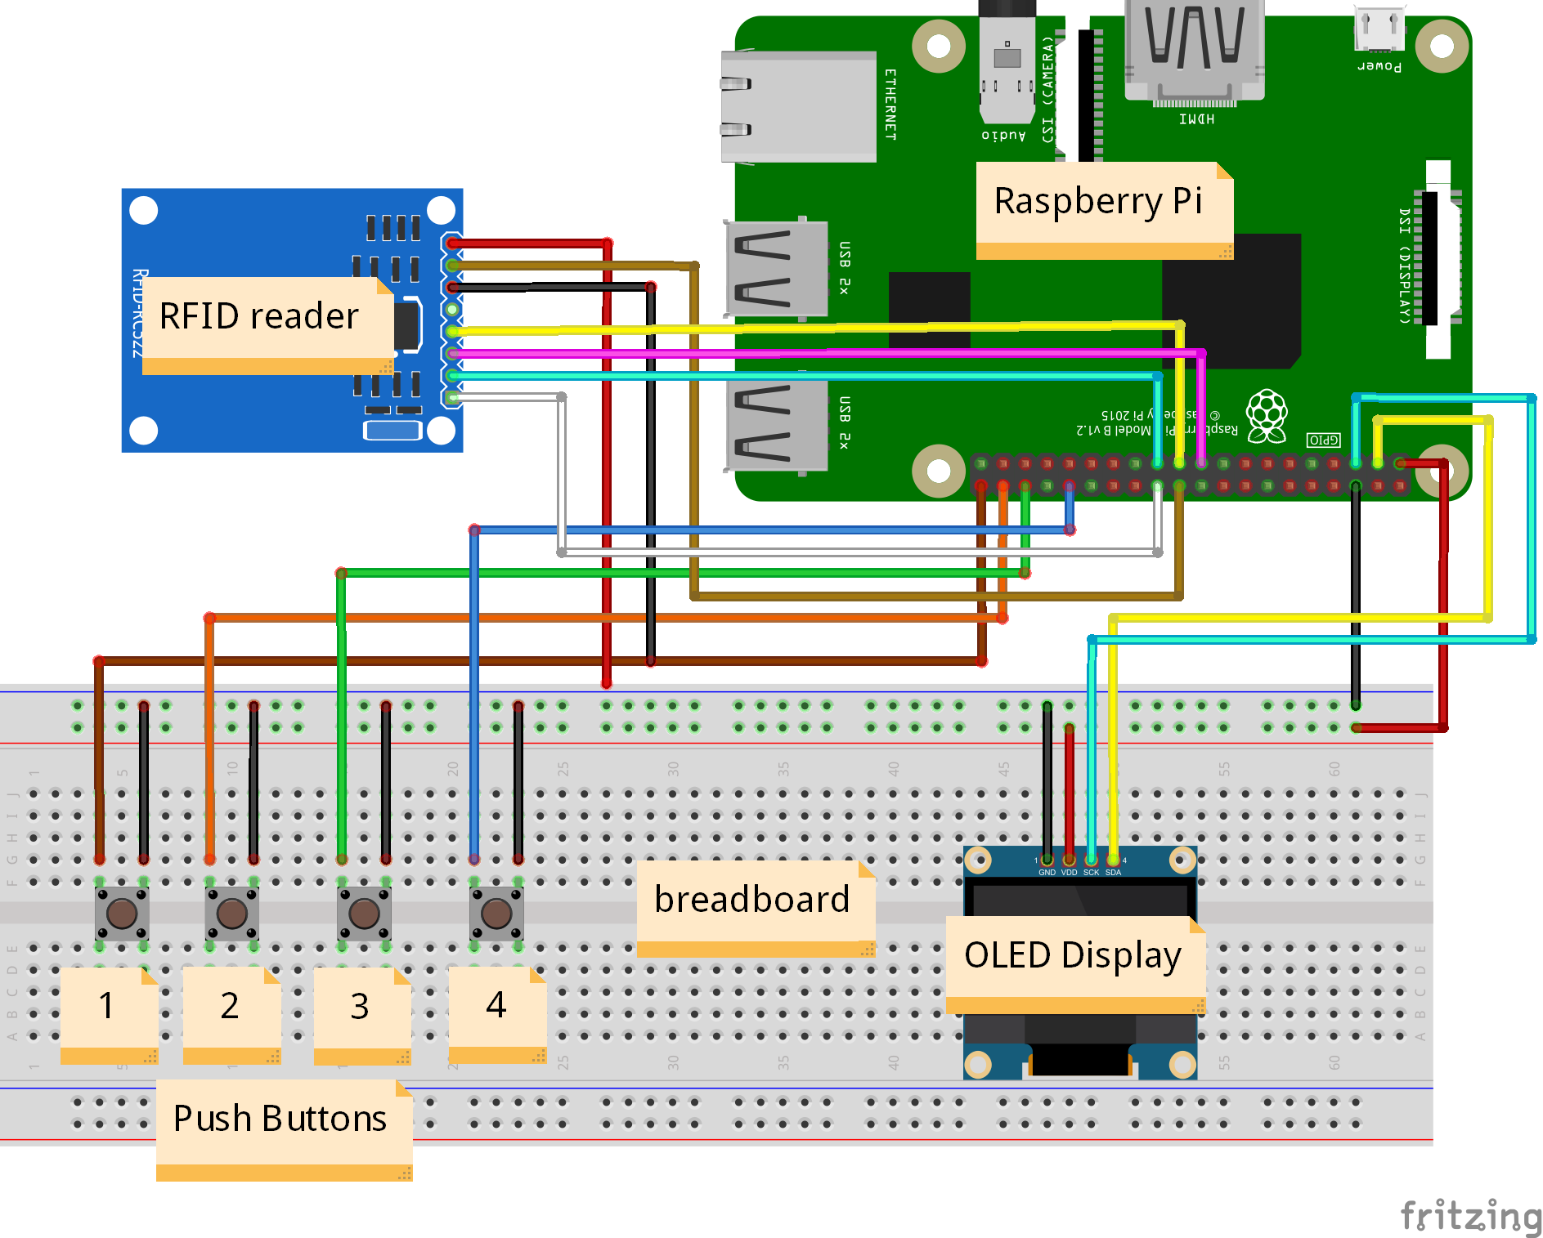
Integrated Circuit
Mac OS 10.14

Slide 19

Google Sheets
Go to the Google Drive.
Create a new Sheets file.
On the Raspberry Pi
pip3 install gspread
pip3 install oauth2client
Mac OS 10.14

Slide 20
Google Sheets
Steps to Enable and Activate the API
Go to the Google API’s Console - https://console.developers.google.com/
Create new project.
Click Enable API. Search for Drive API and Sheets API.
Create Credentials for a Web Server to access Application Data.
Name the Service account and grant it a Project Role of Editor.
Download the JSON File.
Copy the file to the directory and rename it to client_secret.json
Mac OS 10.14

Slide 21
Google Sheets
Steps to Enable and Activate the API
Next, open the client_secret.json and take the client email.
Open your sheets file.
Click the share button and share the file with the client email.
For a full list of the functions possible, check out the Gspread’s API reference page:
https://gspread.readthedocs.io/en/latest/
Mac OS 10.14

Slide 22
THANK YOU!

